Slide 1

Introduction to High Performance Computing
Xiaoyuan Suo Webster University

Slide 2
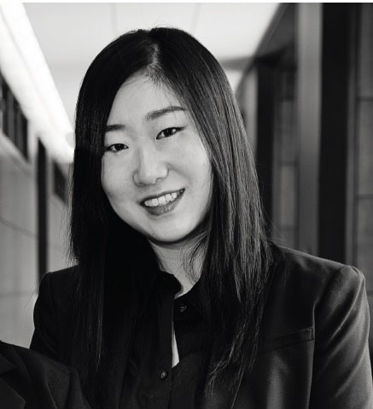
About me
Associate Professor at Webster University,
Computer Science program lead
Data science program lead
Ph.D. in Computer Science,
Dissertation: A Task-Centered Visualization Design Environment and a Method for Measuring the Complexity of Visualization Designs
Current research project
3D photogrammetry Develop a virtual data science lab for midwestern higher education institutions.
Incorporating parallel and distributed computing topics into Lower-Level programming courses.
Teaching and Developing a New Mobile Computing Program
Touch-based visualization system
xiaoyuansuo51@webster.edu

Slide 3
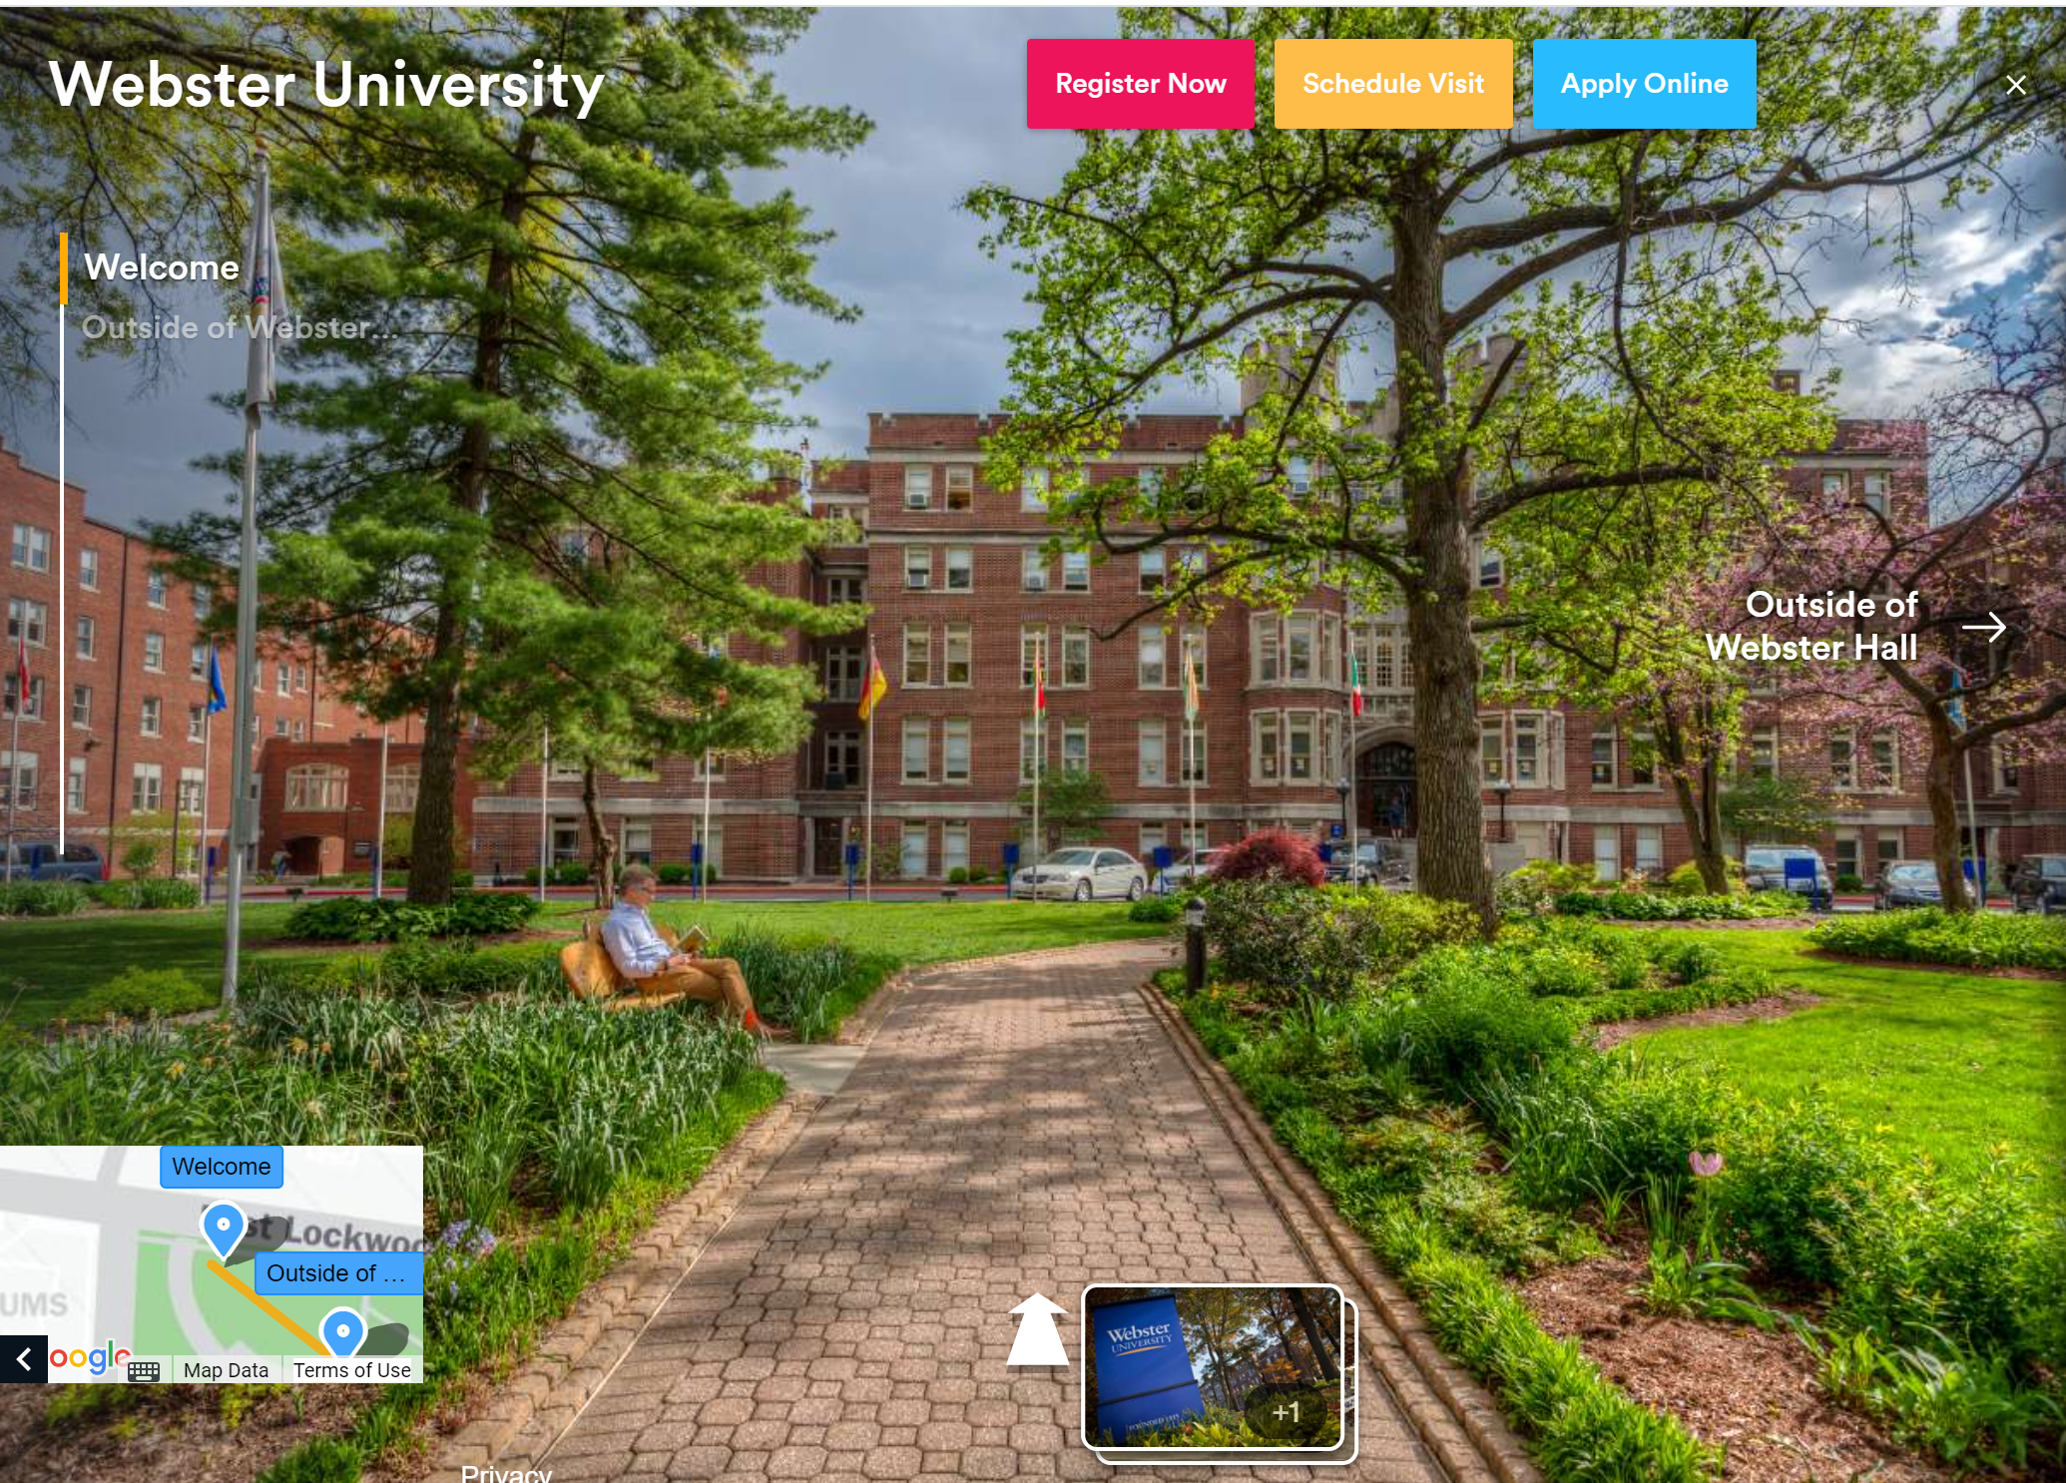
About Webster
https://webster.edu/
Top 20 in Midwest.
50+ sites and locations across four continents
200+ undergraduate programs
STEM graduate programs

Slide 4
我的研究项目
3D photogrammetry
Taking many photographs of an object from a variety of angels and stitching them together to create a 3D model.
High Performance Computing
Computer science education
Improve students' engagement level
Teach computer science classes online

Slide 5

Outline
Basics
Available Tools
Live Demo
My research in HPC

Slide 6
Outline
Basics
Available Tools
Live Demo
My research in HPC

Slide 7

High Throughput Computing and High Performance Computing

Slide 8
High Throughput Computing
High Throughput Computing (HTC) is defined as a type of computing that aims to run a large number of computational tasks using resources in parallel.
Flexibility: HTC is more flexible and can be used for many computing tasks related to business analytics and scientific research.
Cost-Effectiveness: HTC is more cost-effective as compared to the solutions offered by High-Performance Computing(HTC) as it makes use of hardware and software that is available and less expensive and performs more tasks.
Reliability: HTC systems are mostly designed to provide high reliability and make sure that all tasks run efficiently even if any one of the individual components fails.
Resource Optimization: HTC also does proper resource allocation by ensuring that all the resources that are available are efficiently used and accordingly increases the value of computing resources that are available.

Slide 9
Reference
https://portal.osg-htc.org/documentation/support_and_training/training/osgusertraining/

Slide 10

Big Problems
Big problem
Big problem
How do you solve a big computational problem?
E.g.
Lots of data
Thousands of parameters
Many grid points
? ?

Slide 11
Big Solution
Big problem
To solve a big problem, use more computers.
There are different ways to do this:
High throughput computing
High performance computing
Computer by Idealogo Studio from the Noun Project

Slide 12
High Throughput Computing (HTC)
Sub-problems are separate and self-contained with their own input and output. They can be run on many computers.
More scalable.
No special programming needed (no MPI).
n independent* processors
1
2
3
...
n
time

Slide 13
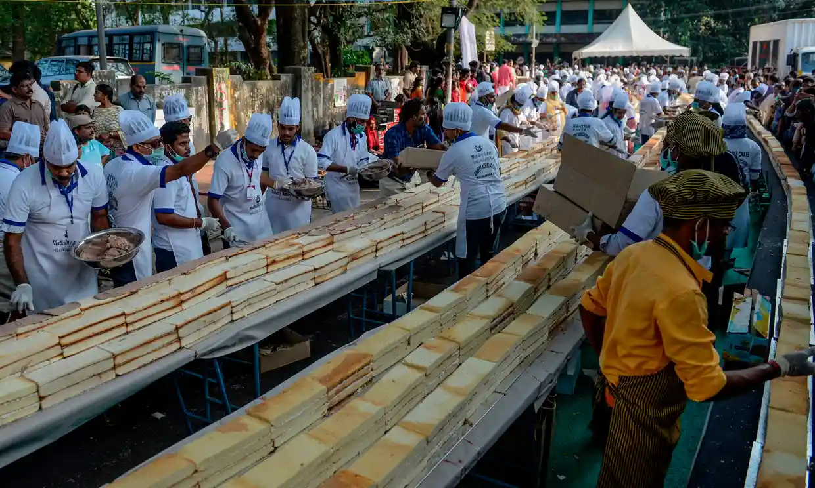

A HTC Analogy
One of our favorite HTC examples: baking the world’s largest/longest cake
In computational terms: solving a big problem (the world’s longest cake) by executing many small, self-contained tasks (individual cakes) and joining them.
Photos: Arun Sankar via https://www.theguardian.com/world/2020/jan/16/indian-bakers-rise-to-task-of-making-worlds-longest-cake

Slide 14
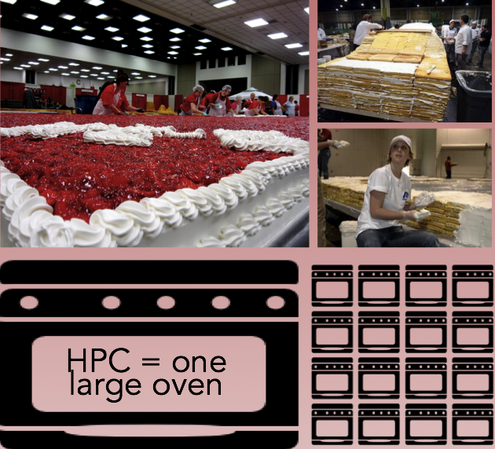
How do you make the world’s largest cake?
Is it necessary to build a very large oven? (the HPC approach - a large singular cluster?)
Potential issues:
Expensive to build/maintain
Wait times could be long

Slide 15
Can the job be split into smaller tasks?
If yes...
Can run on diverse ovens (computers) that don’t have to be colocated.
Easier recovery if one oven (task) fails.
High throughput Many ovens working independently, outputs assembled afterwards
HTC is many small ovens working on pieces of the problem independently

Slide 16
HTC on the Open Science Pool
The OSPool is a good fit for HTC workloads that can be distributed and open:
Jobs are short/resumable
Because the OSPool backfills other resources, interruptions are possible.
Jobs have a laptop-sized resource profile
Best for numerous jobs of one (or few) CPUs and <16GB memory, each.
Individual jobs need/produce less than 20GB of data
Because OSPool resources are distributed across the US (and world) it can be prohibitive for individual jobs that need more than ~20GB of data.
Jobs software and data can be ‘open’
Open-source software (no restrictive licensing), unrestricted data (no HIPAA, etc.)

Slide 17
High Performance Computing
High-Performance Computing(HPC) is a computing technique to process computational problems, and complex data and to perform scientific simulations.
Faster computation: HPC systems can process large and complex calculations and processes faster end efficiently than the traditional approach.
Scalability: HPC systems are more scalable because they can handle many processors and computing nodes according to their applications.
Parallel processing: HPC systems make use of parallel processing to divide the computations into smaller tasks so that they can be processed simultaneously.
Improved accuracy: HPC system performs and gives more accurate simulations and calculations.

Slide 18
Why do you need High Performance Computing?
You need large-scale, HPC-style computing — for your research, for research you support, for your students
Don’t let computing be a barrier to research!
Computing is cheap and plentiful
Push the limits of what you can do
If you run out of science, transcend the boundaries of your science

Slide 19
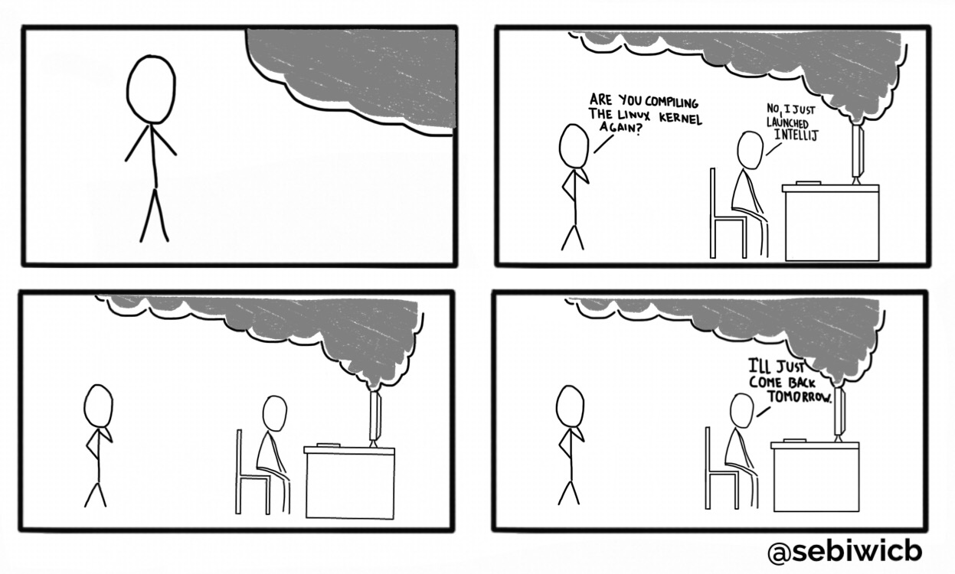
Why Scale Out Your Computing?

Slide 20
Outline
Basics
Available Tools
Live Demo
My research in HPC

Slide 21
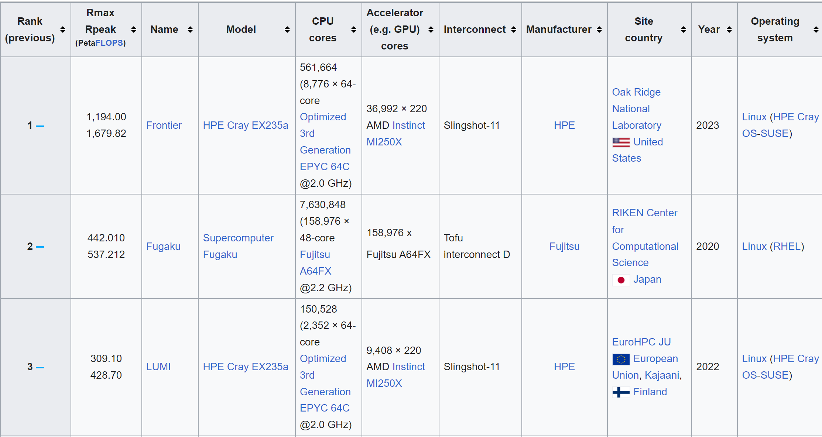
Top500

Slide 22
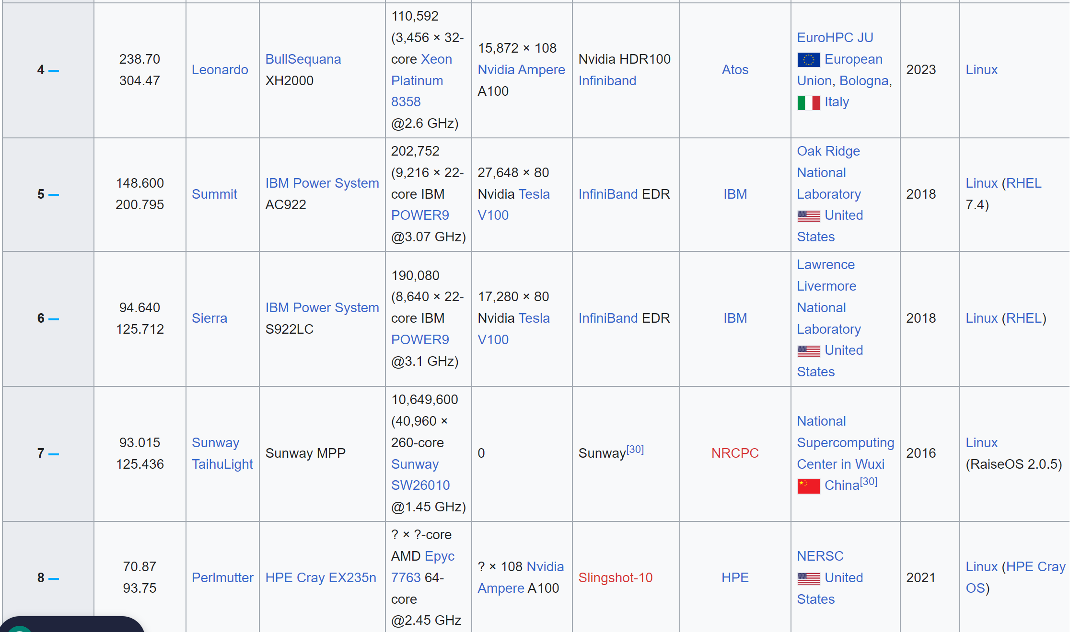
Top 500 (2)

Slide 23

Five Prominent HPC Facilities in China
National Supercomputing Center in Tianjin (NSCC-TJ):
This center houses Tianhe-1A, a supercomputer that was one of the fastest in the world.
National Supercomputing Center in Guangzhou (NSCC-GZ):
This center is home to the Tianhe-2, which was once the world's fastest supercomputer.
National Supercomputing Center in Wuxi (NSCC-WX):
Hosts the Sunway TaihuLight, one of the most powerful supercomputers globally.
Shanghai Superintense Ultrafast Laser Facility (SULF):
While not a conventional supercomputing center, it focuses on intense laser research and applications.
Piz Daint,
Swiss National Supercomputing Centre (CSCS) Collaboration: While physically located in Switzerland, Piz Daint is noteworthy for its collaboration between the Swiss CSCS and China's National Supercomputing Center in Guangzhou.

Slide 24
Outline
Basics
Available Tools
Live Demo
My research in HPC

Slide 25
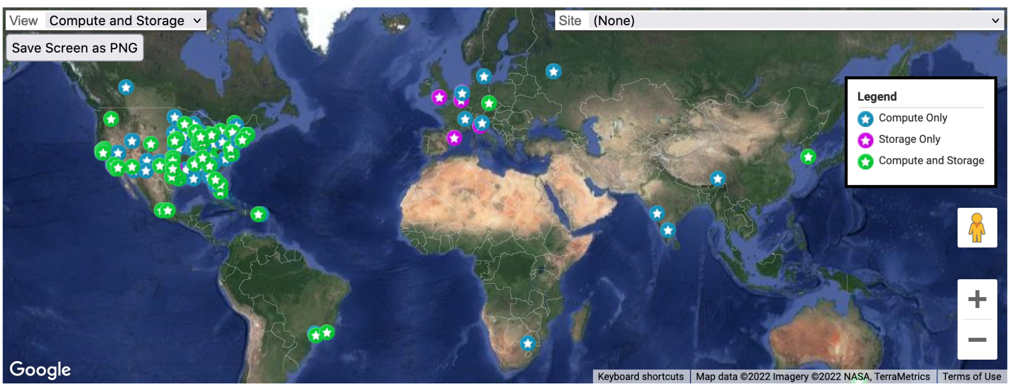
What is the OSG?
The OSG Consortium builds and operates a set of pools of shared computing and data capacity for distributed high-throughput computing (dHTC).
https://display.opensciencegrid.org

Slide 26

Open Science Pool
One of these pools, the Open Science Pool (OSPool) is operated for all US-associated open science.
OSPool
Computer by miracle from NounProject.com
26

Slide 27

Open Science Pool
One of these pools, the Open Science Pool (OSPool) is operated for all US-associated open science.
OSPool
Computer by miracle from NounProject.com
OSPool Access Point
27

Slide 28
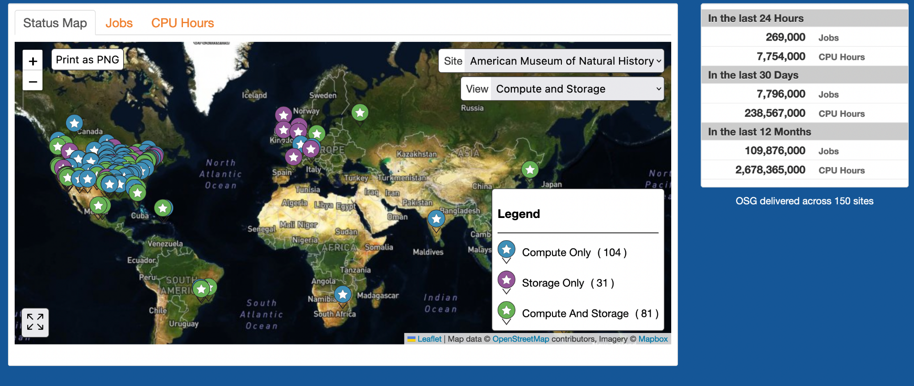
OSG Size and Scale
Last 12 months: 109M jobs - 2.6B compute hours
Notes:
Image last updated January 2023

Slide 29
HTC on the Open Science Pool
The OSPool is a good fit for HTC workloads that can be distributed and open:
Jobs are short/resumable
Because the OSPool backfills other resources, interruptions are possible.
Jobs have a laptop-sized resource profile
Best for numerous jobs of one (or few) CPUs and <16GB memory, each.
Individual jobs need/produce less than 20GB of data
Because OSPool resources are distributed across the US (and world) it can be prohibitive for individual jobs that need more than ~20GB of data.
Jobs software and data can be ‘open’
Open-source software (no restrictive licensing), unrestricted data (no HIPAA, etc.)

Slide 30
What workloads are good for HTC? (OS-Pool)*
 | Ideal Jobs! (up to 10,000 cores across Jobs, per user!) | Still Very Advantageous! | Less-so, but maybe
Cores (GPUs) | 1 (1; non-specific type) | <8 (1; specific GPU type) | >8 (or MPI) (multiple)
Walltime | <10 hrs* *or checkpointable | <20 hrs* *or checkpointable | >20 hrs
RAM | <few GB | <10s GB | >10s GB
Input | <500 MB | <10 GB | >10 GB
Output | <1 GB | <10 GB | >10 GB
Software | ‘portable’ (pre-compiled binaries, transferable, containerizable, etc.) | most other than → | Licensed software; non-Linux
* the “less-so, but maybe” column could still be an HTC workload, but one that would run more effectively on a local, dedicated HTC system instead of the OSPool

Slide 31



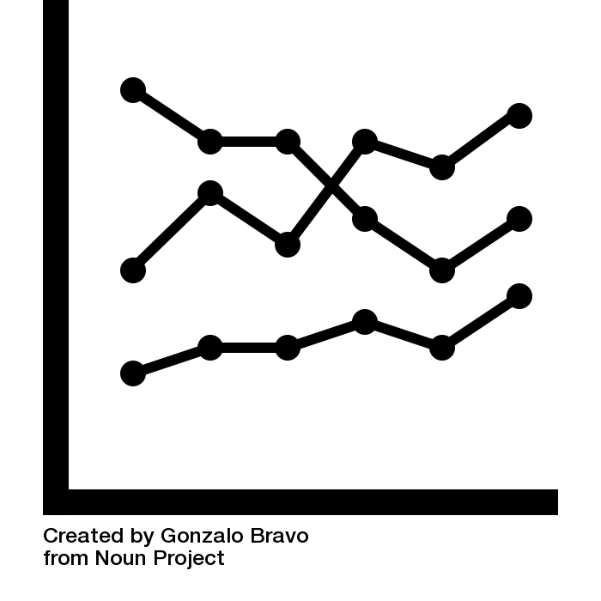
dHTC-Friendly Research Problems*
DNA by Arafat Uddin from the Noun Project
Image by Shastry from the Noun Project
grid by Nawicon Studio from the Noun Project
Line Graph by Gonzalo Bravo from the Noun Project
RNA/DNA sequence alignment | statistical model optimization | parameter sweep | multiple image/sample analysis
*not exhaustive!

Slide 32
OSPool Research Examples
Researcher talks at 2020 OSG All Hands Meeting
https://indico.fnal.gov/event/22127/timetable/#20200831.detailed
Researcher talks at 2019 OSG User School
https://opensciencegrid.org/user-school-2019/#materials/
Researcher talks at 2019 OSG All Hands Meeting
https://indico.cern.ch/event/759388/timetable/#20190319.detailed

Slide 33
The Open-Science-Grid
You need:
Browser
https://notebook.ospool.osg-htc.org/hub/login?next=%2Fhub%2Fuser%2Forcid%253A0000-0003-2473-0705%2Flab
ORCID, gmail account, university subscription, facebook….
Select “data science” to include Python Libraries
Terminal with SSH log in

Slide 34

How It Works
1. Log in to an OSG Access Point*
and upload data/software
Computer by miracle from NounProject.com
Laptop by Petr Bilek from NounProject.com

Slide 35
How It Works
1. Log in to an OSG Access Point*
and upload data/software
Computer by miracle from NounProject.com
Laptop by Petr Bilek from NounProject.com
2. Create a job submit file.
Notes:
Add example file name in parens?

Slide 36
How It Works
3. Submit jobs via HTCondor
1. Log in to an OSG Access Point*
and upload data/software
Computer by miracle from NounProject.com
Laptop by Petr Bilek from NounProject.com
2. Create a job submit file.

Slide 37



How It Works
4. Jobs run on
3. Submit jobs via HTCondor
1. Log in to an OSG Access Point*
and upload data/software
Computer by miracle from NounProject.com
Laptop by Petr Bilek from NounProject.com
OSPool Member Sites
Other Resources*
(Cloud, cluster allocations)
2. Create a job submit file.
*talk to the OSG team for details

Slide 38
HTCondor Job Flow
OSPool Access Point
/home/user
Job Components
Software
Scripts
Input Data
HTCondor Submit File
38

Slide 39
HTCondor Job Flow
OSPool Access Point
/home/user
Job Components
Software
Scripts
Input Data
HTCondor Submit File
$ condor_submit SubmitFile.submit
39

Slide 40
HTCondor Job Flow
OSPool Access Point
Executable
Input Files
Job Resources
Error/Log Files
Number of Jobs
/home/user
Job Components
Software
Scripts
Input Data
HTCondor Submit File
40

Slide 41

HTCondor Job Flow
OSPool Execute Point
Job specifications
/condor/scratch
OSPool Access Point
Software
Scripts
Input Data
/home/user
HTCondor
Job Components
Software
Scripts
Input Data
HTCondor Submit File
41

Slide 42
HTCondor Job Flow
OSPool Execute Point
/condor/scratch
OSPool Access Point
Software
Scripts
Input Data
Output Data
Log/Error/Out
/home/user
HTCondor
Job Components
Software/Code
Scripts
Input Data
HTCondor Submit File
Output transferred
back
42

Slide 43
Outline
Basics
Available Tools
Live Demo
My research in HPC

Slide 44
Promoting High Performance Computing in PUIs Research
Empowering Future Innovators
Equipping undergraduates with HPC skills empowers them to tackle complex scientific challenges and drive innovation in their respective fields.
Enhancing Research Capabilities
HPC allows students to perform simulations, data analysis, and modeling at a scale that is otherwise unattainable, enabling deeper insights and more impactful research outcomes.
Preparation for Real-World Demands
As HPC becomes increasingly prevalent across industries, students with HPC proficiency are better prepared for the job market and industry demands.
Interdisciplinary Collaboration
HPC proficiency encourages collaboration between STEM disciplines, promoting a holistic approach to problem-solving and fostering innovation at the intersection of fields.
Global Research Participation
HPC skills enable students to engage in international research collaborations and contribute to solving global challenges.

Slide 45
Projects
Gravitational Wave Emission from Super massive Black Hole Mergers
Pseudo-Jahn-Teller Effect in Saturated Cyclic Organic Molecules
Computation of Phase Stability and Magnetic Interactions in Hybrid Organic Inorganic Crystalline Materials
Parallelize Massive Security Log Analysis
Self-Replicating Sequences and the Shape of Genomes
Virtual Data Science Lab
Astronomical Data Analysis for advanced astronomy class project
Cyber Range Platform for Cybersecurity Labs

Slide 46
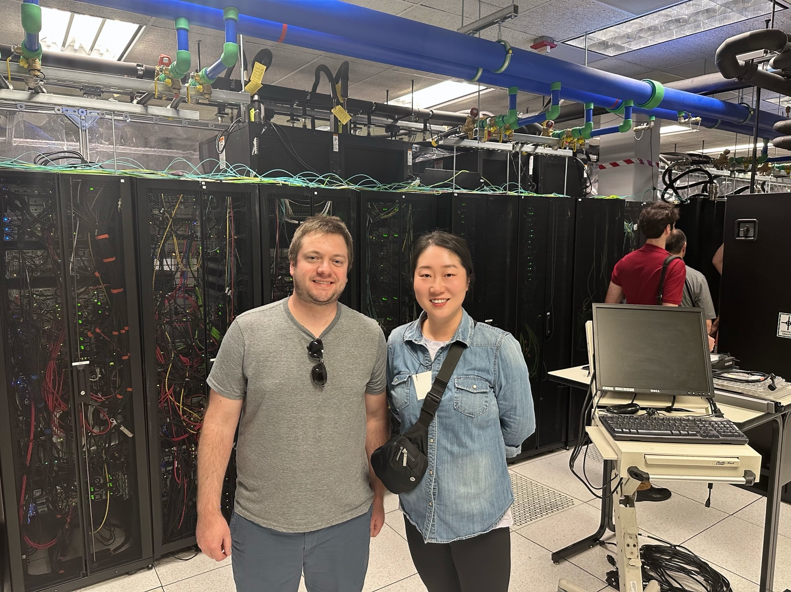
The facility
https://docs.rnet.missouri.edu/services/

Slide 47
我的联系方式
Xiaoyuansuo51@webster.edu
314-246-2359
Webster University, St.Louis, MO

Slide 48


